Slide 1
Skin lesions
Maeve Kenningham (MBChB MRCGP DipDerm)
Notes:
Maeve Kenningham qualified 21 years. GP 16 years. Im GP in Wrexham, GP trainer, RCGP, post grad Dermatology 10 years ago, Dermatology tutor for Cardiff Uni and been Specialty Dr in derms. Aesthetic practice we have an excellent opportunity to educate our patients and spot nasties.

Slide 2
Aims:
Opportunity to see those at risk of sun related skin cancers and promote good skin health
Appreciating what common skin lesions malignant and benign can look like
Complexity of making correct diagnosis (Consultant Derms can get it wrong) and dangers of no histology
Defer aesthetic treatment and signpost if concerns?
Notes:
The sun and extrinisic aging processes often prompt these people to come to see us to “correct” years of sundamage.
This lecture is NOT about making you diagnosticians. , exercise caution offering lesion removal without histology.

Slide 3
The skin
Notes:
Discuss levels

Slide 4
Epidermis
Notes:
Keratinocytes discussion
Langerhans- antigen presenting cells
Merkel- mechanorecption
Note melanocyte 1:8 ratio with keratinocytes, Tan is never healthy skin

Slide 5
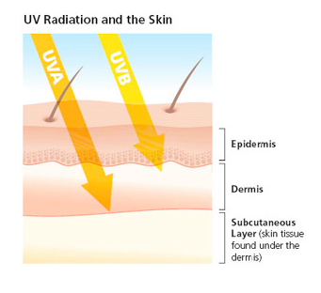

Slide 6
UVA vs UVB
95% of radiation to earth
X50 more prevalent than UVB
Pentrates deeper skin
All year round
Penetrates clouds, glass
Tanning photoaging
<5%
X1
Pentrates to basal layer
Spring to Autumn
Doesn’t penetrate glass
Sunburning, tanning, photoaging
Notes:
Tanning booths emit X12 times strength of UVA than sun.

Slide 7
Sun related damage (extrinsic)
Notes:
66 yr old lorry driver after 28 years of driving truck.
Yellowing thickening skin Solar elastosis, comedones, cobblestone appearance, wrinkling, furrows

Slide 8
Sunbeds:
X12 UVA from sun
X2.5 risk of SCC
X1.5 risk of BCC
If use when <35yrs 75% increase in melanoma risk.
Notes:
International Agency for Research on Cancer found that 1st exposure to sun beds before 35 yrs increases risk by 75%!

Slide 9
Vit D and the sun
15 mins in sun (UVB), expose 1/3 skin, to boost Vit D levels essential for bone health
Supps 600IU/day
80-90% of vit D produced by UVB on 7dehydrocholesterol on skin
Notes:
Beneficial effects on bone well established Other health benefits mooted but not established (colorectal ca, DM, CVD

Slide 10
Most common skin cancers:

Slide 11
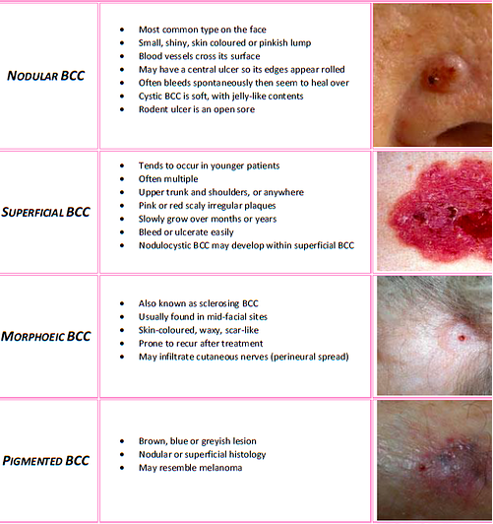
Notes:
Discuss BCCs origin and types and why. Photographs from Primary Care Dermatology Society, great resource.

Slide 12
AK, Bowens (SCC in situ), SCC
Notes:
Talk about precursors and conversion to SCCs

Slide 13
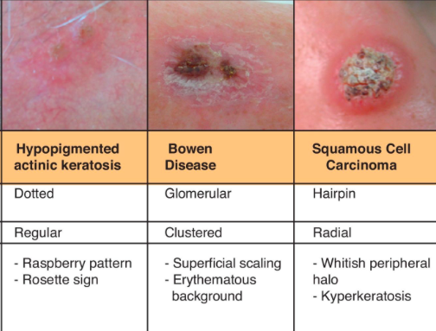

Slide 14
Moles ABCD
Notes:
From Primary Care Dermatology Society

Slide 15
Moles EFG

Slide 16
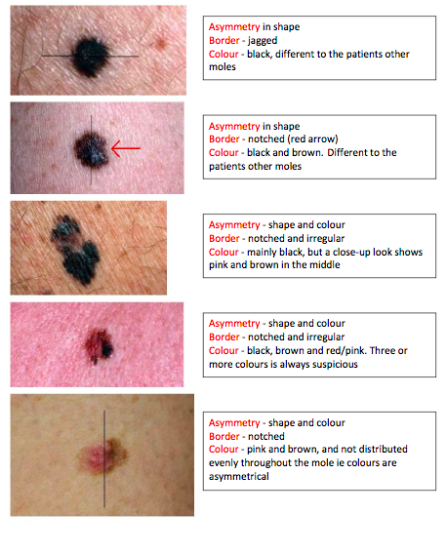
Notes:
PCDS

Slide 17
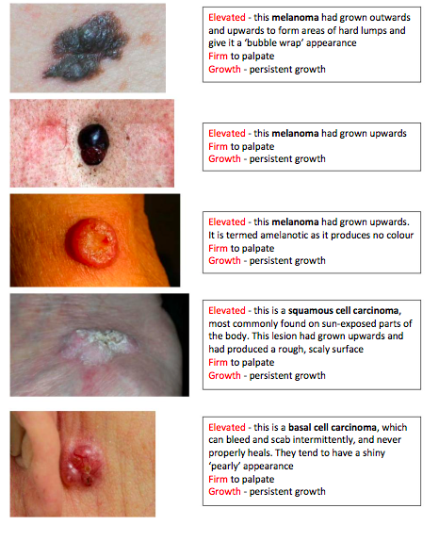
Notes:
PCDS

Slide 18
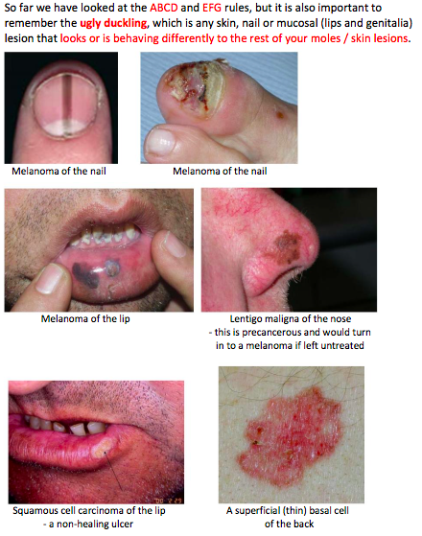
Notes:
PCDS

Slide 19
Notes:
It is useful to have a ruler in these photos to estimate size.
Atypical mole syndrome discuss
Mole mapping discuss.

Slide 20
Quick fire round
Label these as
Benign
Malignant
Brownie points if diagnosis

