Slide 1
Skin lesions
Can be found on the face
Notes:
A lot of photos from PCDS

Slide 2
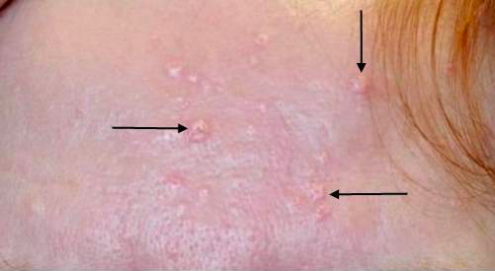
Notes:
Sebaceous hyperplasia
Curette cryo laser

Slide 3
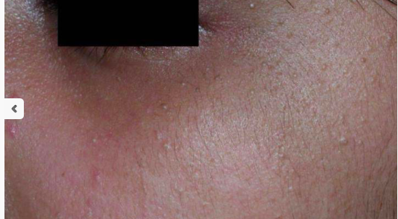
Notes:
Milia
Subepidermal keratin containing cysts comes with sun damage
Curette laser TCA peels

Slide 4
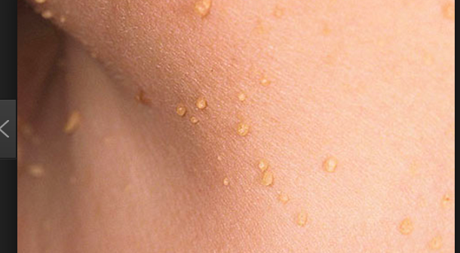
Notes:
Skin tags
Unknown cause (bunching of collagen), known sites of predeliction neck under arm, under breasts, groin – often obese people skin rubbing.
Cryo laser Hyfrecator tying off

Slide 5
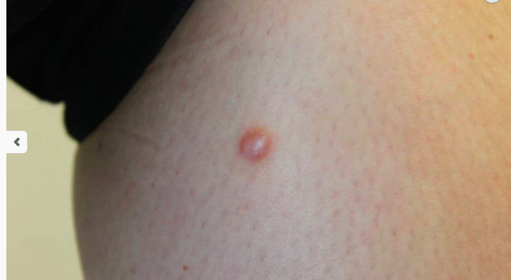
Notes:
Dermatofibroma
Cause uncertain- inflammatory response to insect bite? Predilection to arms and legs.
Excision.

Slide 6
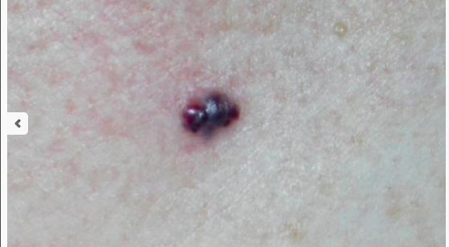
Notes:
Angioma
Syn haemangioma
Endothelial hyperplasia ( overgrowth of a blood vessel)
Compressible

Slide 7
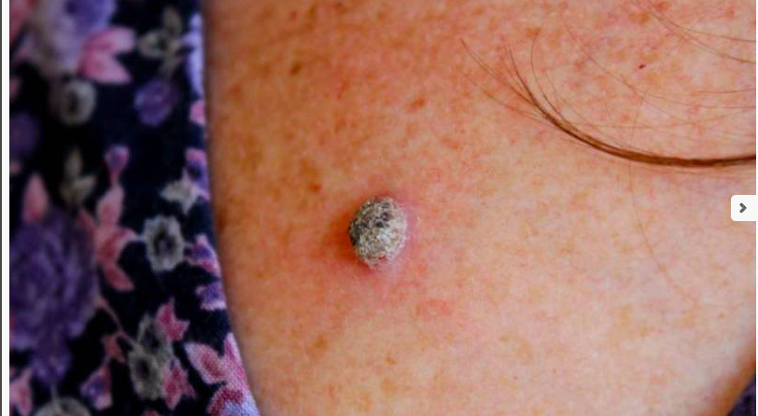
Notes:
Growing in last 2 months
Viral wart
Infection in epidermis causes proliferation of cells. Human papilloma virus
Thrombosed capillary vessels black dots

Slide 8
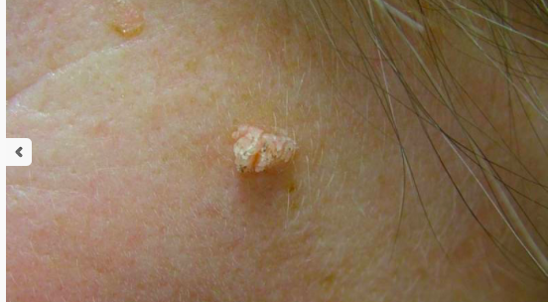
Notes:
Grown in 2 mths
Filiform wart

Slide 9
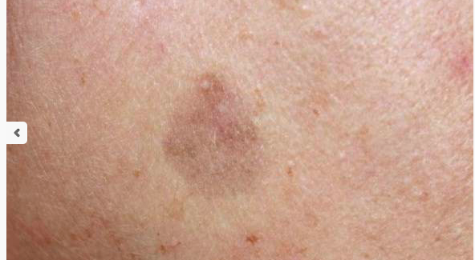
Notes:
Lichenoid keratosis
Inflammatory reaction to a seb keratosis or solar lentigines, usually 4-12 mths.
Cryo curette hyfrec.

Slide 10
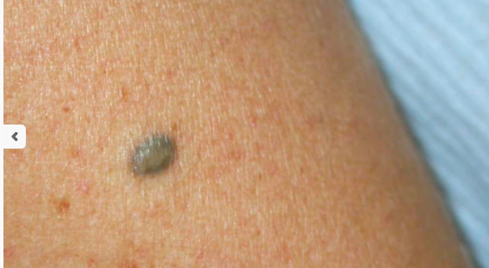
Notes:
There for yrs Not changed much, lighter?
Blue Naevus
Blue because melanocytes deeper in skin

Slide 11
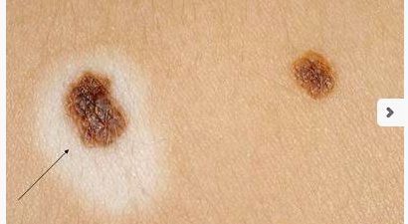
Notes:
Halo naevus
Refer if in an older person

Slide 12
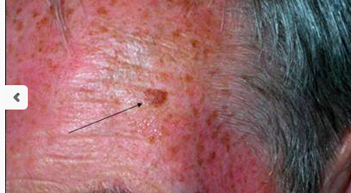
Notes:
New appearance after sunny holiday
Lentigines
Unlike a Freckle (ephilis ) it doesn’t fade.
Due to prolifer of melanocyctes along BM (precursor to seb k)
Rx hydroquinon, azeliac acid, alpha hydroxy peels, vit c, retinoic acid, cryo lasers.

Slide 13
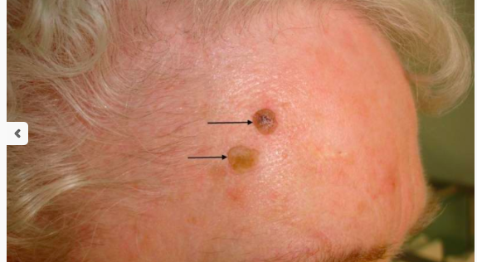
Notes:
There for 6 mths recently itchy
Seb keratosis
Stuck on warty plaque or current bun appearance
Cause unknown
More of them as skin degenerates
Can follow sunburn or dermatitis
Not associated with sebaceous gland
Black skin known as dermatosis papulosa nigra
Scrape, cryo hyfrec, tca peels

Slide 14
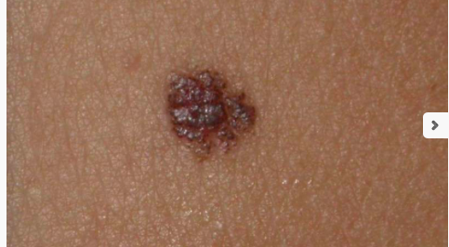
Notes:
There for years No change
Dermal naevus
Proliferation or nest of melanocytes in the dermis

Slide 15
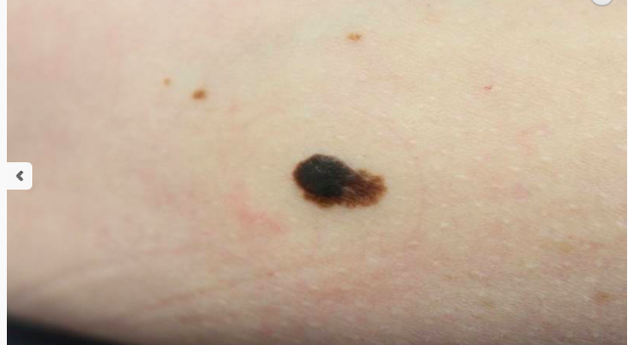
Notes:
Grown in last 2 mths
melanoma

Slide 16
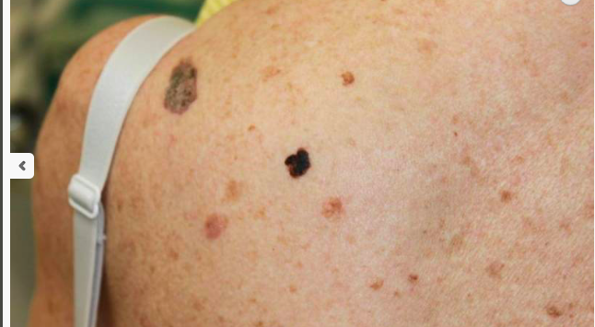
Notes:
No changes perceived
L shoulder SK medial to that is the ugly duckling MM

Slide 17
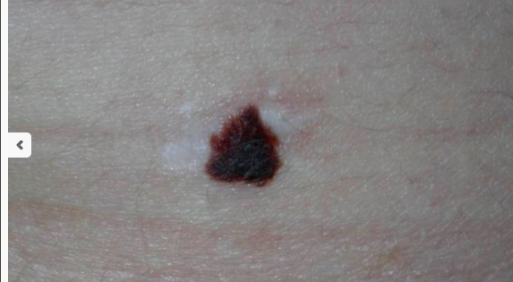
Notes:
Under is site of previous excision but not sent for histology as looked benign, new lesion appeared within 3 mths.
MM

Slide 18
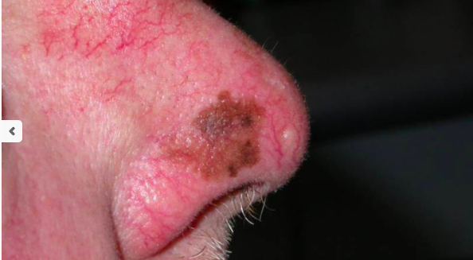
Notes:
Lentigo maligna
Slow growing precusor to MM
Variation of colour, more nodular and variety of colours sign transformation . 5% transform

Slide 19
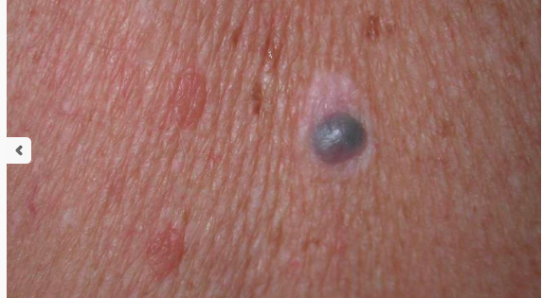
Notes:
There for few mths, now pallor around it
Nodular Melanoma regressing

Slide 20
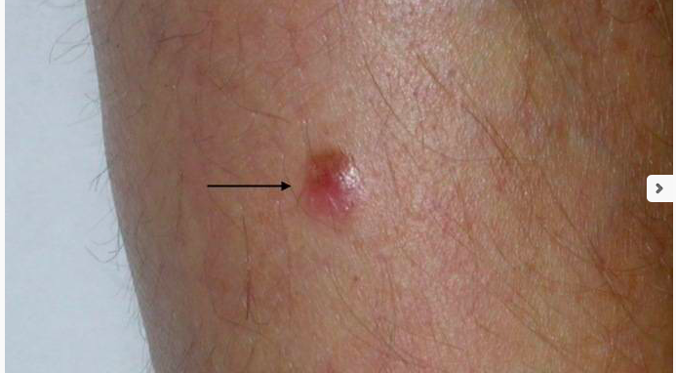
Notes:
New growing lesion
Nodular melanoma

Slide 21
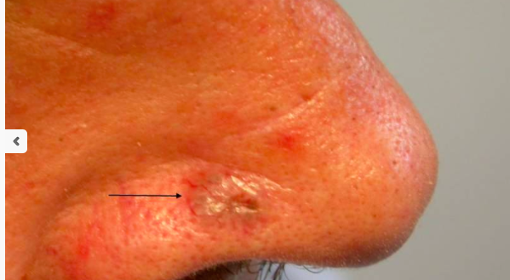
Notes:
Crusting sore never goes away. There for a yr
Nodular BCC/rodent ulcer

Slide 22
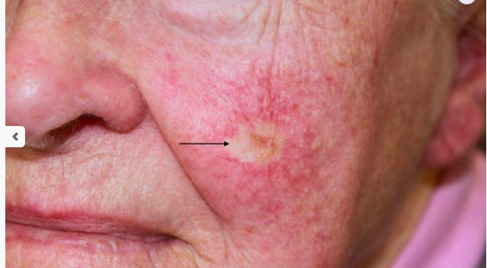
Notes:
Morphoeic BCC

Slide 23
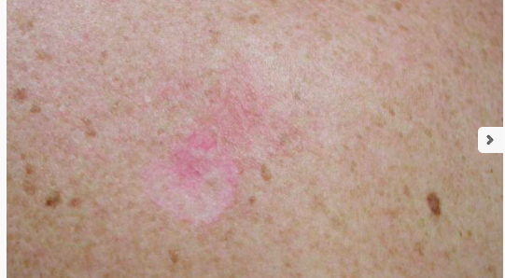
Notes:
Superficial BCC

Slide 24
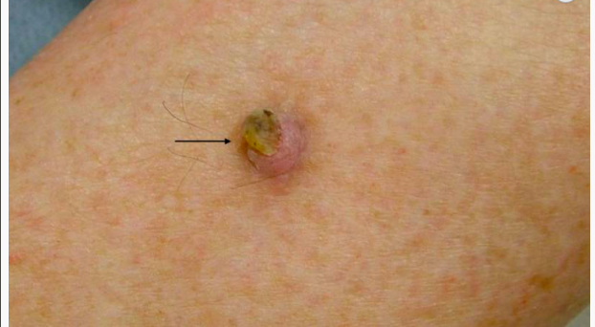
Notes:
Well differentiated SCC. Discuss undifferentiated

Slide 25
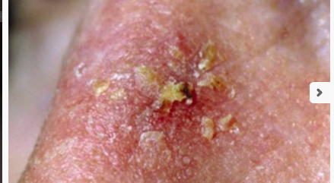
Notes:
AK

Slide 26
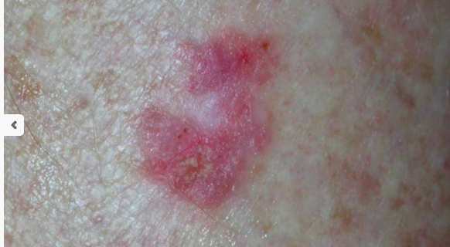
Notes:
Bowens

Slide 27
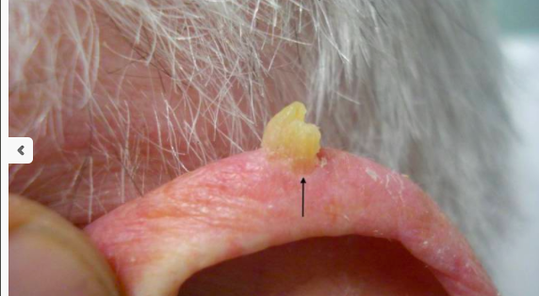
Notes:
Cutaneous horn
Underlying AK but could be SCC

Slide 28
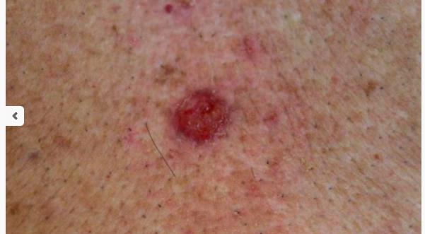
Notes:
Poorly differentiated scc

Slide 29
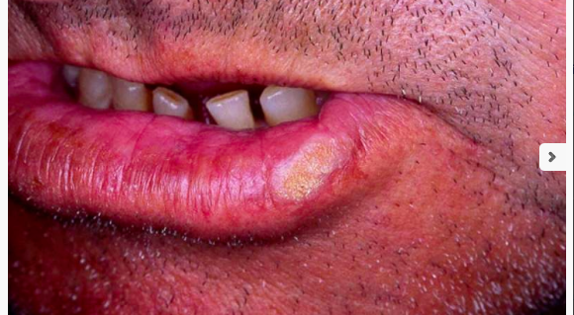
Notes:
SCC lips prone to metastasising

Slide 30
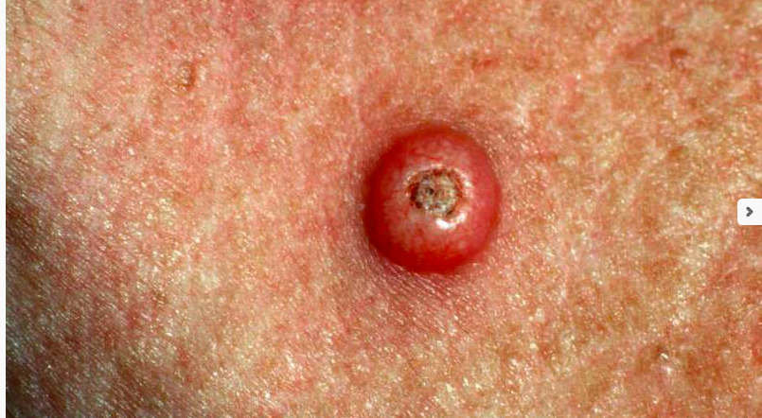
Notes:
KA. discuss

Slide 31
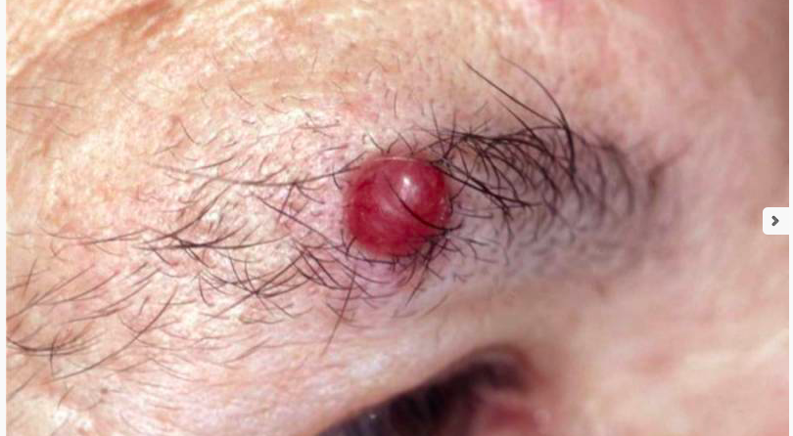
Notes:
Fast growing Over 65 Lot of sun exposure in life
MCC-50% mortality rate highly aggressive
Not mentioned metastatic deposits, lymphoma of skin, cutaneous manifestations of systemic disease,, etc

