Slide 1
Tear Trough Rejuvenation
Dr Simon Berrisford

Slide 2
Outline
Tear trough is major concern in those seeking peri-orbital rejuvenation
It is a natural consequence of ageing of the anatomical attachments around the orbit
Historical treatments were surgical excision and chemical peels eg. Phenol
Today multiple modalities may be used such as BoNT and HA fillers

Slide 3
What is a tear trough?
Known as the naso-jugal groove
Caused by the orbicularis retaining ligament
This is weakest in the middle and attaches nasally
Loss of malar fat pads exposes this area further causing a groove in shadow
Can be demonstrated by flash photography

Slide 4
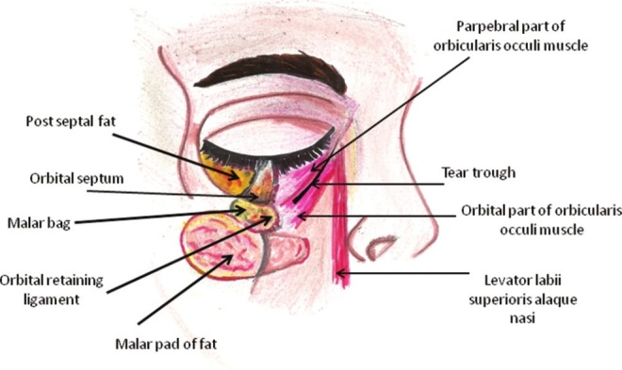
Tear Trough Anatomy

Slide 5
Grading the Trough
Saddick’s TTRS (Tear Trough Rating Scale)
Hyper-pigmentation
None - 1 point
Mild - 2 points
Moderate - 3 points
Intense - 4 points

Slide 6
Grading the Trough
Prolapse of nasal fat pad
Mild 1 point
Moderate 2 points
Severe. 3 points

Slide 7
Grading theTrough
Rhytidosis
Mild 1 point
Moderate 2 points
Severe 3 points

Slide 8
Grading the Trough
Each millimetre of depth is given one point

Slide 9
Hirmands Classification

Slide 10
Hirmand’s Classification

Slide 11
Hirmand’s Class 1

Slide 12
Hirmand’s Class 2

Slide 13
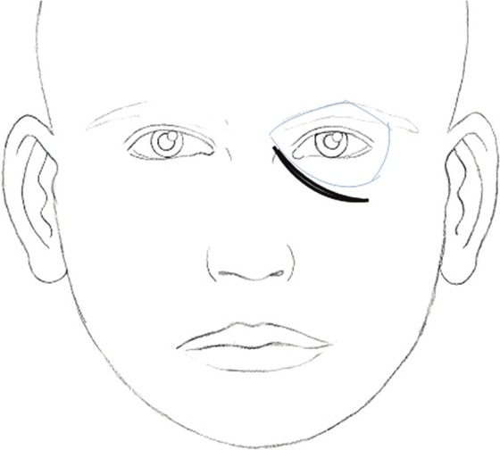
Hirmand’s Class 3

Slide 14
Example Tear Trough

Slide 15
Contraindications
Unrealistic expectations
Local infection
Allergy/hypersensitivity
Septal fat herniation
Connective tissue disease - elastosis

Slide 16
Risks
Central Retinal Artery occlusion = blindness
Oedema taking months to resolve. DISCUSSION POINT
Post-inflammatory hyper pigmentation
Bruising
Infection
Vascular compromise
Lumps or nodules of product
Headache or migraine
Tyndall effect

Slide 17
Technique
Appropriate HA filler material
Teosyal Redensity II
Revolax Fine
Juvederm Ultra

Slide 18
Lambro’s Technique
Finger to guard orbit
Needle inserted into most lateral point of trough
Advanced to full length toward medial canthus
HA injected into deep dermis
Needle removed and multiple rows repeated
Massage to shape

Slide 19
Kane’s Technique
Skin of lower lid stretched
30g needle at deepest point of trough
Injected above level of orbicularis oculi
Multiple threads inserted below deep rhytids

Slide 20
Stutman & Codner Technique
HA injected in pre-periosteal plane
HA below level of orbicularis
Again needle used with threading and cross-hatching

Slide 21
Steinsapir Technique
Again a needle
Serial puncture technique along trough
Starting laterally and moving nasally
Injection is flush to periosteum
0.1ml per injection

Slide 22
Consensus Group
Consensus Group of European and North and South American Experts to create best practice guideline
Recommendation was the Vertical Supraperiosteal Depot Technique VSDT
30g cannula

Slide 23
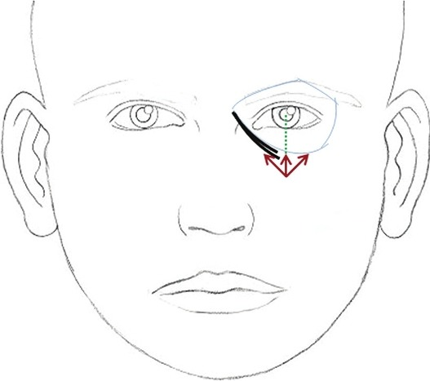
Marking up

Slide 24
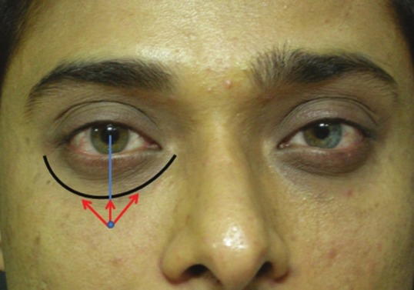
Markup in Vivo

Slide 25
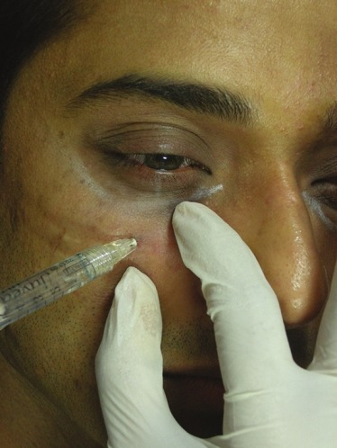
Consensus Technique
S
Sub periosteal injection via cannula - towards medial canthus

Slide 26
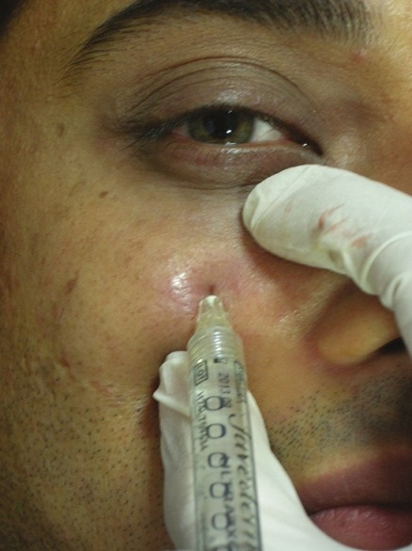
Consensus Technique
Sub periosteal injection towards mid pupillary line

Slide 27
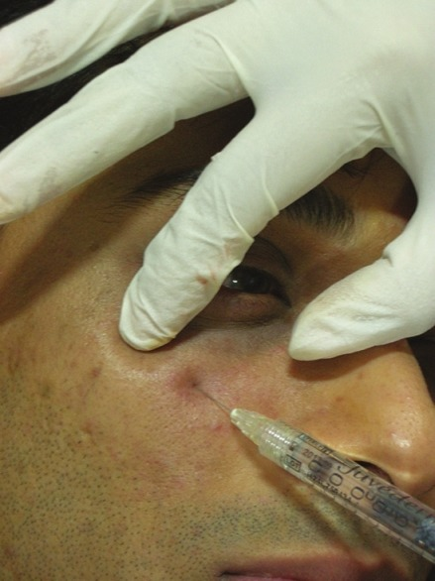
Consensus Technique
Sup periosteal injection towards lateral canthus

Slide 28
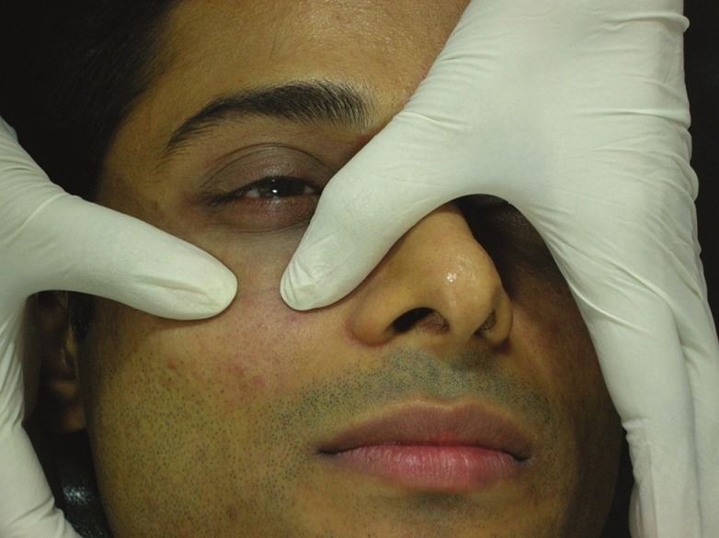
Consensus Technique
Massage product gently for even distribution

Slide 29
Practical Session
Treatment of two patients
Simon doing one and Ryan the other
Delegates can do own models
Simon providing some filler samples to use

Slide 30
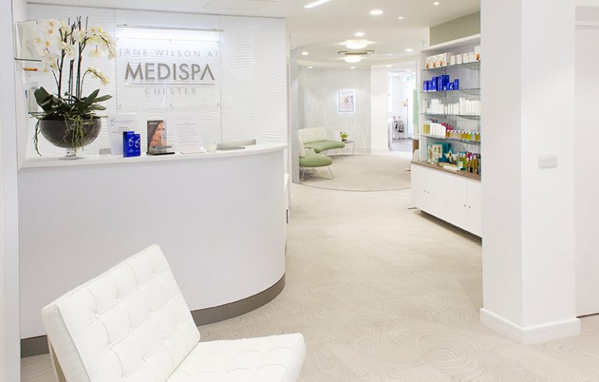
sb@chestermedispa.co.uk
sb@chestermedispa.co.uk

