Slide 1
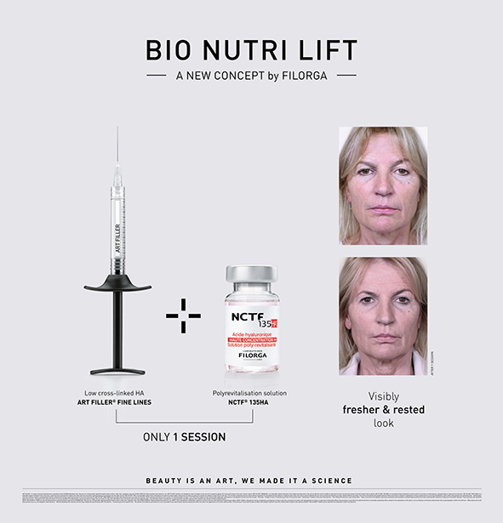
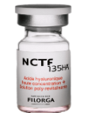
BIONUTRILIFT
AN EXCLUSIVE PROTOCOL BY FILORGA

Slide 2
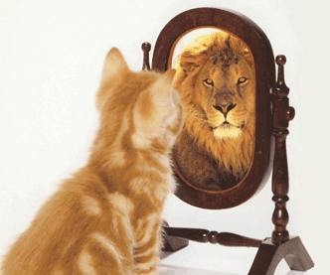
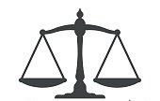
WOMEN’s Aesthetic expectations
KEY POINTS
  Natural results and minimum downtime (1ST fear for injections)
  Looking for better confidence and self esteem
  Cost level: 2 ^{ND} barrier for aesthetics procedure
  Confidence in the product and injectors
  Safe procedure : 3 ^{RD} barrier of injections
  Skin appearance : concerns 75% of women undergoing HA injections
  Spot, skin tonicity, pore size , slackening, glow ,homogeneity …….
ART SURVEY & IFOP DATA 2016

Slide 3

BIO NUTRI LIFT: INDICATIONS lift effect & facial rejuvenation
Prevention and treatment of quality of skin at any age
Correction of superficial skin reliefs
Prevention and treatment of skin sagging
Correction of shadows
Can be combined with all aesthetic procedures
  Volumetry
  Surgery
  Laser
  Peeling

Slide 4
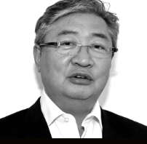
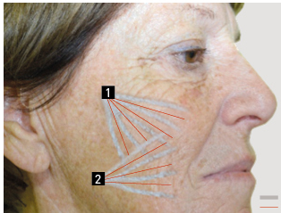
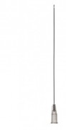
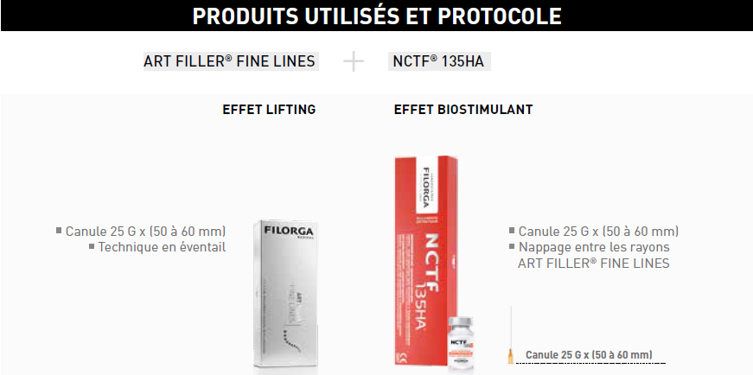

BIO NUTRI LIFT: A NEW CONCEPT BY FILORGA
COMBINATION OF CROSS LINKED HA + POLYREVITALISATION SOLUTION
DEVELOPED BY
Dr MAXENCE CAILLENS
1. LIFTING EFFECT
2. REVITALISING EFFECT
EXCLUSIVE CANNULA
25G 55 MM
Only 1 session
AVAILABLE IN MAY 2018

Slide 5
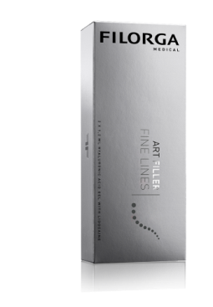
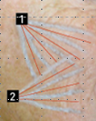


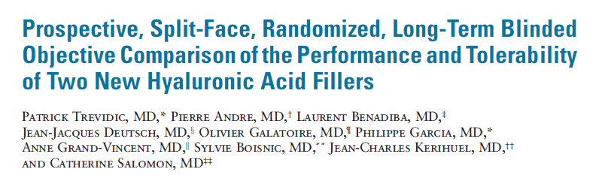
BIO NUTRILIFT: scientific RATIONAL
COLLAGEN INDUCTION
1. CROSS-LINKED HA GEL
2. CANNULA 25G / 55mm
3. FANNING TECHNIQUE
Inflammation and Healing process
Vectors of force
DERM SURG 2017

Slide 6
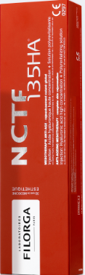
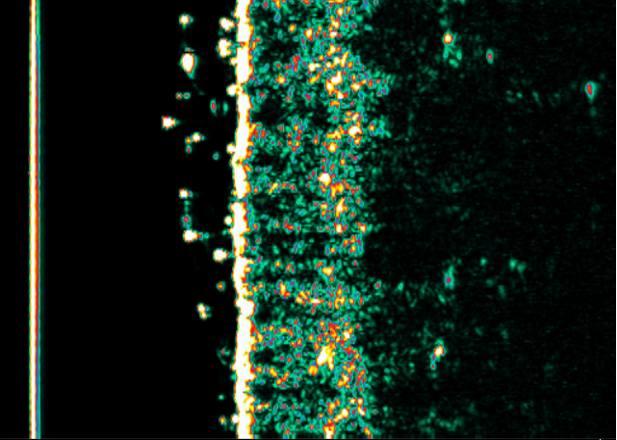
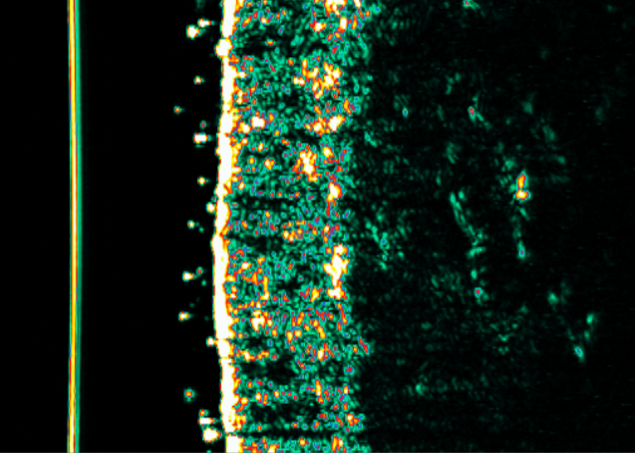
BIO NUTRILIFT: SCIENTIFIC RATIONAL nctf135 HA :HIGH QUALITY SKIN IMPROVMENT
1. FREE HA 5 mg/ml + 59 INGREDIENTS
2. CANNULA 25G /55mm
3. FANNING TECHNIQUE
Fibroblast stimulation
Neo-collagenesis
Dermis rejuvenation
Skin quality improvement
  Proven firming effect*
    +20% dermal thickness
    +24% dermal density
Instrumental Study realized by an independant Clinical Research Center in Dermatology (GREDECO, Paris, France) on 18 subjects.

Slide 7


BIO NUTRILIFT: TECHNIQUE
ONLY 2 ENTRY POINTS ON EACH HALF-FACE
ENTRY POINT BY THE ZYGOMATIC ARCH
- 3 to 5 fanning lines with ART FILLER Fine Lines
towards the nasolabial fold using the retrograde technique
- Nappage in between with NCTF 135HA
ENTRY POINT ABOVE THE MANDIBULAR ANGLE
- 3 to 5 fanning lines with ART FILLER Fine Lines
towards the labial angle and nasolabial fold using
the retrograde technique
- Nappage in between with NCTF 135HA

Slide 8
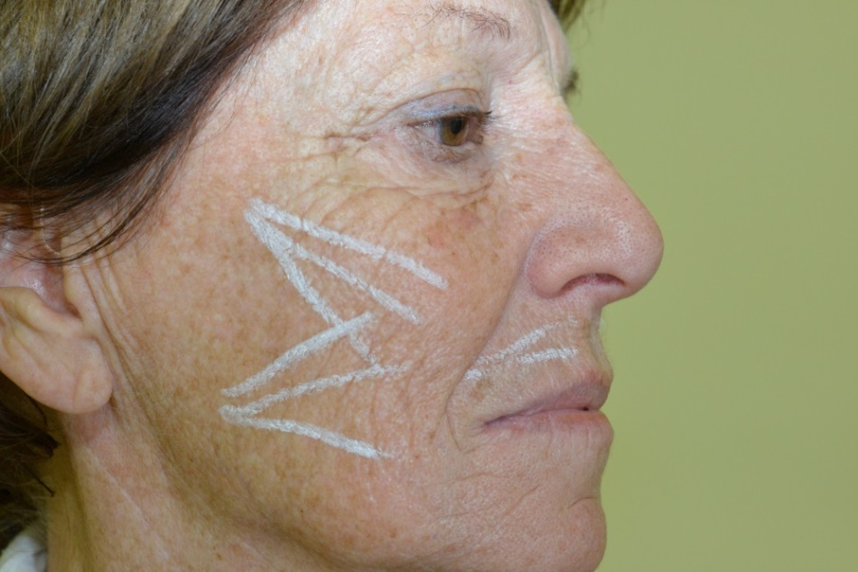
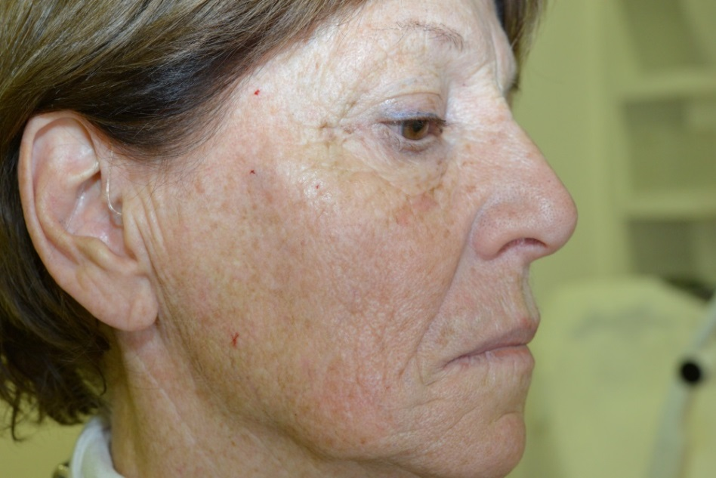
BIO NUTRILIFT
RESULTS
BEFORE WITH MARKINGS
IMMEDIATELY AFTER
1 ART FILLER Fine Lines - 1 NCTF 135HA per Side

Slide 9
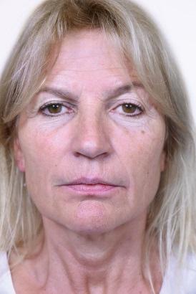
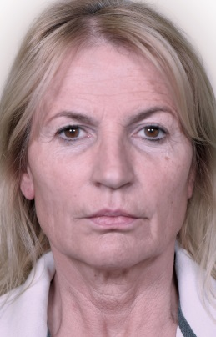
BIO NUTRILIFT: RESULTS
Visibly fresher & rested look
BEFORE
1 MONTH AFTER
1 ART FILLER Fine Lines - 1 NCTF 135HA per Side

Slide 10

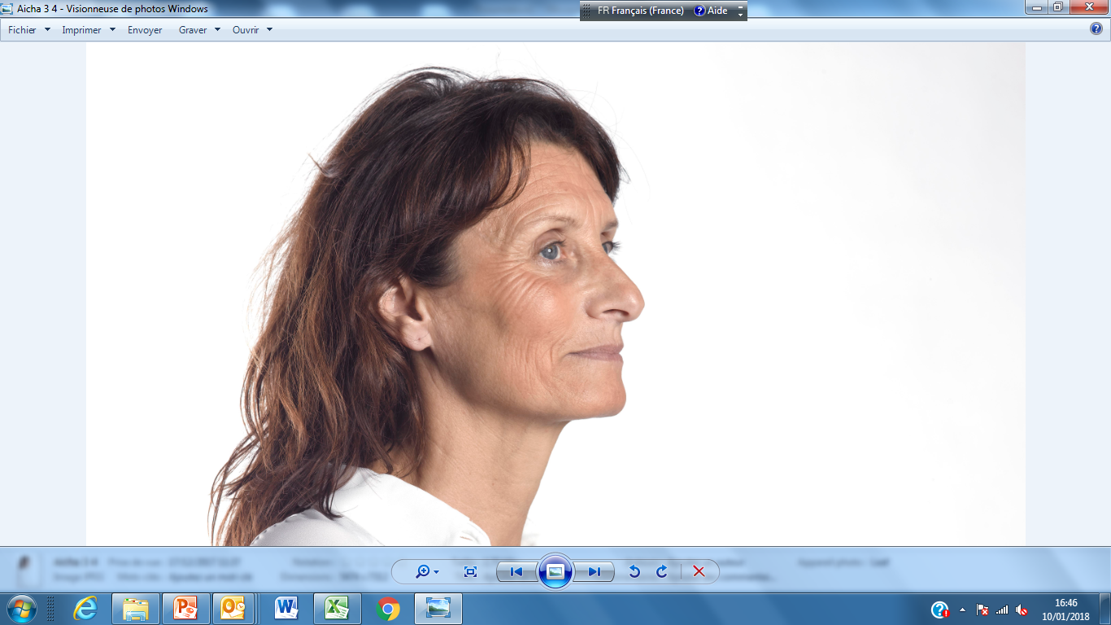
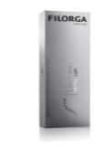
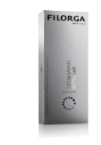
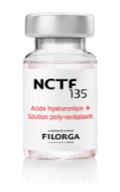
BIO NUTRILIFT: PROTOCOL
TUNABLE TO THE LEVEL OF SKIN AGING
-
SKIN AGING
NUMBER OF VECTORS
UPPER
VECTOR
UPPER +LOWER VECTORS
TYPE & ML
OF CROSS LINKED HA
ART FILLER FINE LINES
ART FILLER UNIVERSAL
Upper vector
QUANTITY NCTF 135HA
Lower vector
lift & revitalising effect in 1 session using cannula

Slide 11
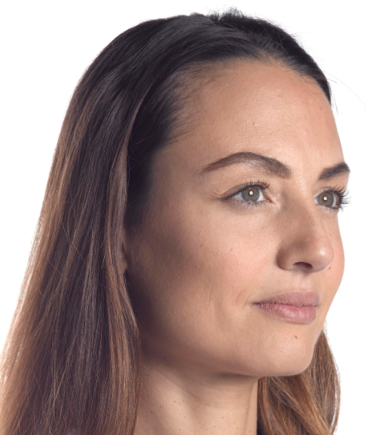
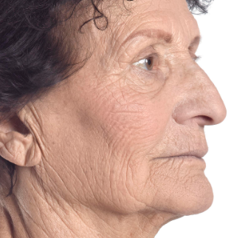
BIONUTRILIFT: CUSTOMIZED TO PATIENT AGEING
ART FILLER + NCTF
Upper vector
Upper vector
Upper vector
Lower vector
Lower vector
NCTF® 135HA
NCTF® 135HA
ART FILLER® Universal
ART FILLER® Fine Lines
ART FILLER® Fine Lines
NCTF® 135HA

Slide 12
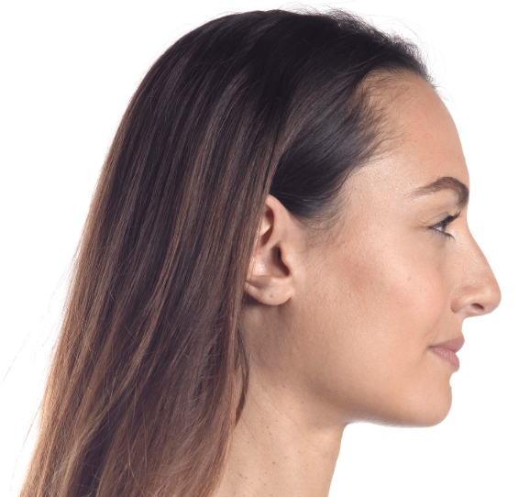
BIONUTRILIFT PORTFOLIO
BASIC: ART FILLER FINE LINES+ NCTF
BIONUTRILIFT BASIC | VECTORS | PER SIDE | TOTAL
 | UPPER | Fine lines ½ ml + NCTF 1/2 VIAL | 1ml Fine Lines 3ml NCTF
Upper vector

Slide 13
BIONUTRILIFT PORTFOLIO
BASIC DUO : ART FILLER FINE LINES+ NCTF
Upper vector
BIONUTRILIFT BASIC DUO | VECTORS | PER SIDE | TOTAL
 | UPPER LOWER | Fine lines 1 ml + NCTF 1 VIAL | 2 ml Fine Lines 6 ml NCTF
Lower vector

Slide 14
BIONUTRILIFT PORTFOLIO
FORTE : ART FILLER UNIVERSAL+ NCTF
BIONUTRILIFT | VECTORS | PER SIDE | TOTAL
FORTE | UPPER | Universal ½ ml + NCTF 1/2 VIAL | 1ml Universal 3ml NCTF
Upper vector

Slide 15
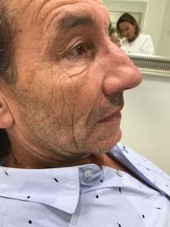
BIONUTRILIFT PORTFOLIO
FORTE : ART FILLER UNIVERSAL+ NCTF
BIONUTRILIFT | VECTORS | PER SIDE | TOTAL
FORTE DUO | UPPER LOWER | Universal1 ml/ + NCTF 1 VIAL | 2ml Universal 6ml NCTF
Upper vector
Lower vector

Slide 16
BIONUTRILIFT
EXCLUSIVE PROTOCOLS
BIONUTRILIFT BASIC | VECTORS | PER SIDE | TOTAL
 | UPPER | Fine lines ½ ml + NCTF 1/2 VIAL | 1ml Fine Lines 3ml NCTF
BIONUTRILIFT BASIC DUO | UPPER LOWER | Fine lines 1 ml + NCTF 1 VIAL | 2 ml Fine Lines 6 ml NCTF
BIONUTRILIFT FORTE | UPPER | Universal ½ ml + NCTF 1/2 VIAL | 1ml Universal 3ml NCTF
BIONUTRILIFT FORTE DUO | UPPER LOWER | Universal1 ml/ + NCTF 1 VIAL | 2ml Universal 6ml NCTF

Slide 17


BIO NUTRILIFT
BENEFITS
FOR THE PHYSICIAN
FOR THE PATIENT
Ease of injection , cannula expertise
Good ratio cost /effectiveness Short procedure: 20 minutes
Immediate and long lasting natural results Excellent tolerance
Easily combined with other treatments: filler, mesotherapy, toxine, laser , surgery
Visible results at 1st session No transformation ,major enhancement
Very comfortable, no down time and side effect
Good ration cost / effectiveness
Long lasting effect

Slide 18
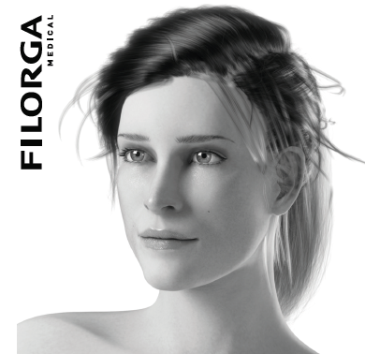
BIO NUTRI LIPS
a new FILORGA concept for
rejuvenating the peri-oral region

Slide 19
Extend the protocol
BIO NUTRI lips
Peri-oral aging
Thinning of skin – restructure & revitalize
Loss of support – lift & fill
Loss of volume – replace volume
Muscular changes - maintain muscular functionality and expression

Slide 20
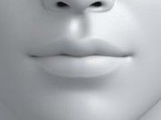
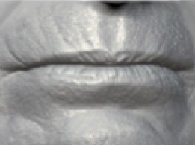
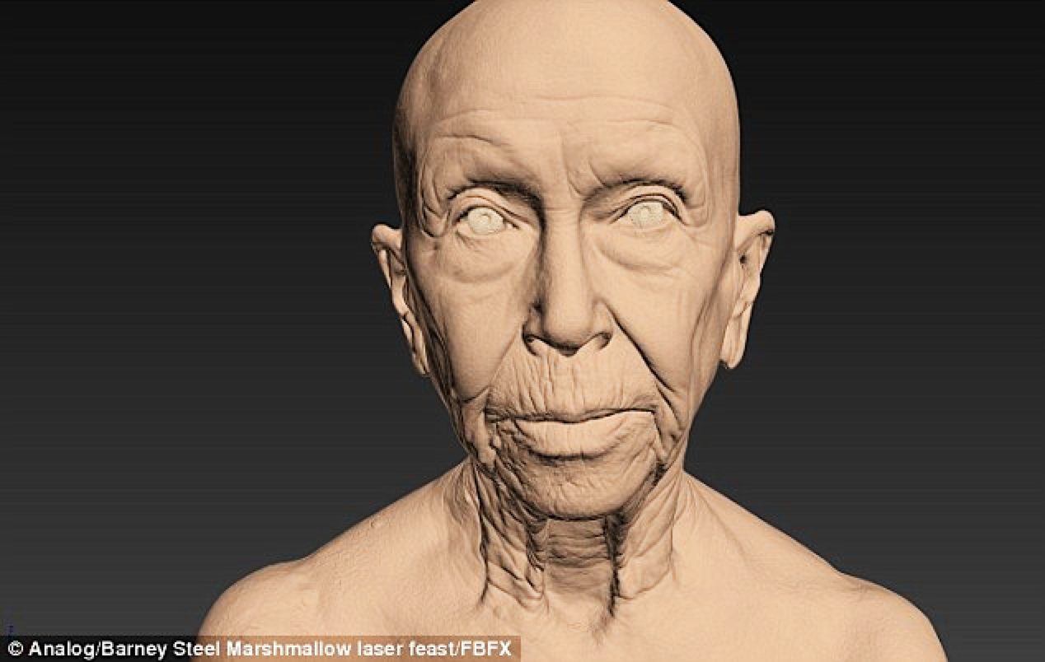
COMBINING FILORGA’S PORTFOLIO
ACCORDING TO AGEING GRADE
GRADE 1
GRADE 2
GRADE 3
NCTF135HA
NCTF135HA
FINE LINES
NCTF135HA
FINE LINES
UNIVERSAL
NCTF135HA
NCTF135HA
FINE LINES
NCTF135HA
FINE LINES
UNIVERSAL

Slide 21
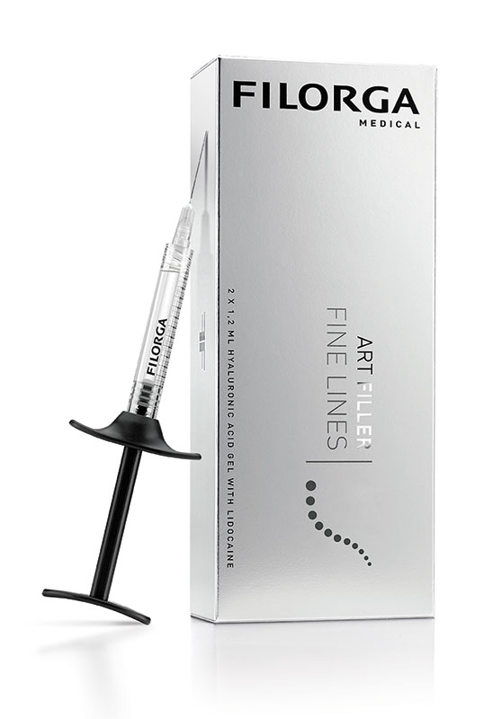
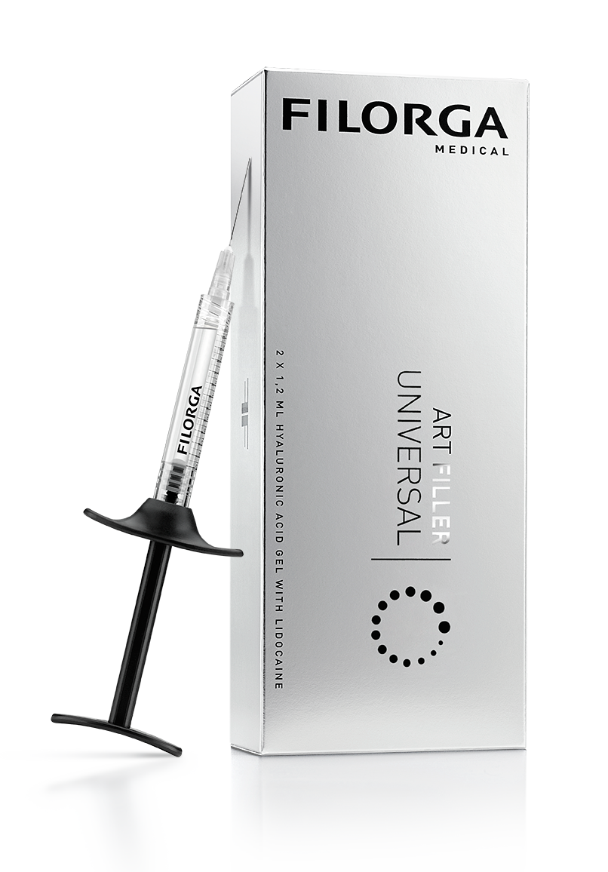
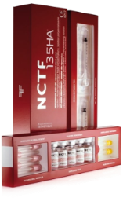
COMBINING FILORGA’S PORTFOLIO
ART FILLER®
Fine Lines
ART FILLER®
Universal
NCTF® 135HA

Slide 22
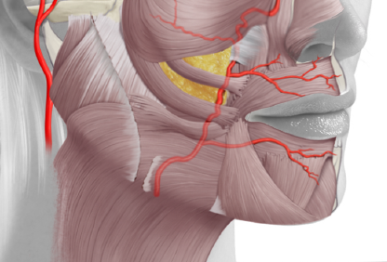
ANATOMY & VASCULAR STRUCTURES

Slide 23
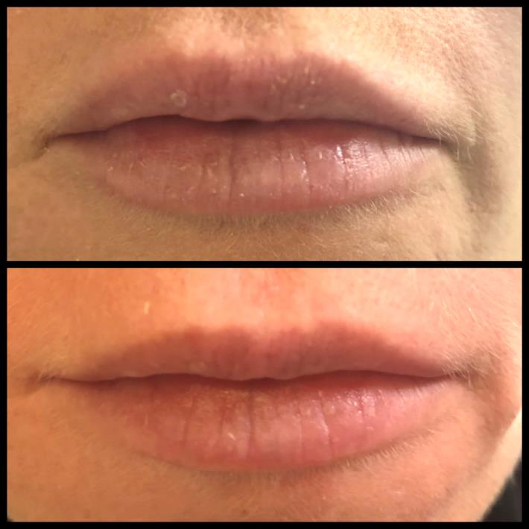
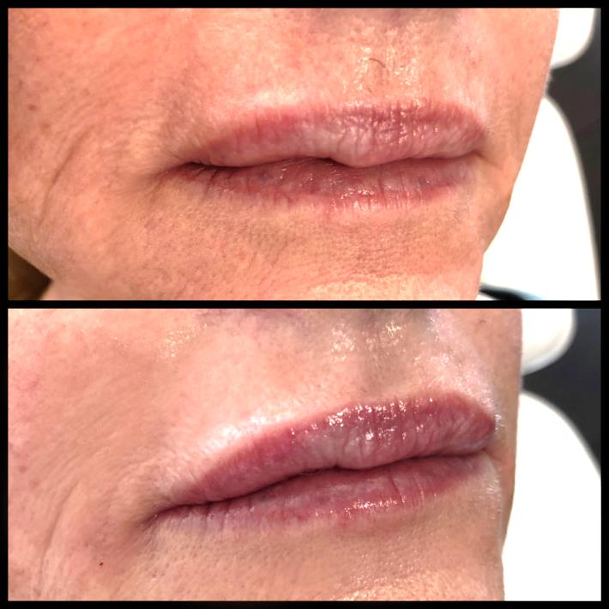
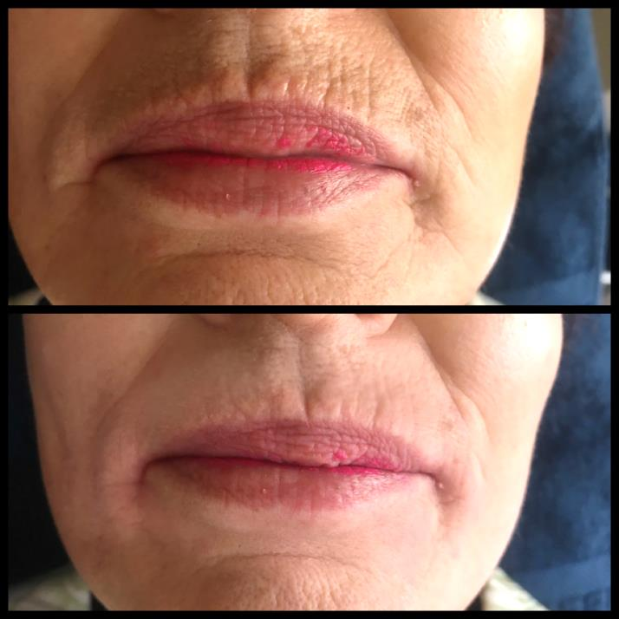
BIO NUTRI LIPS
NATURAL RESULTS

Slide 24
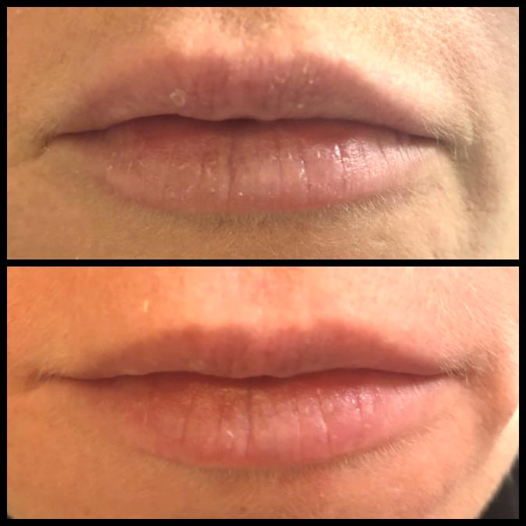
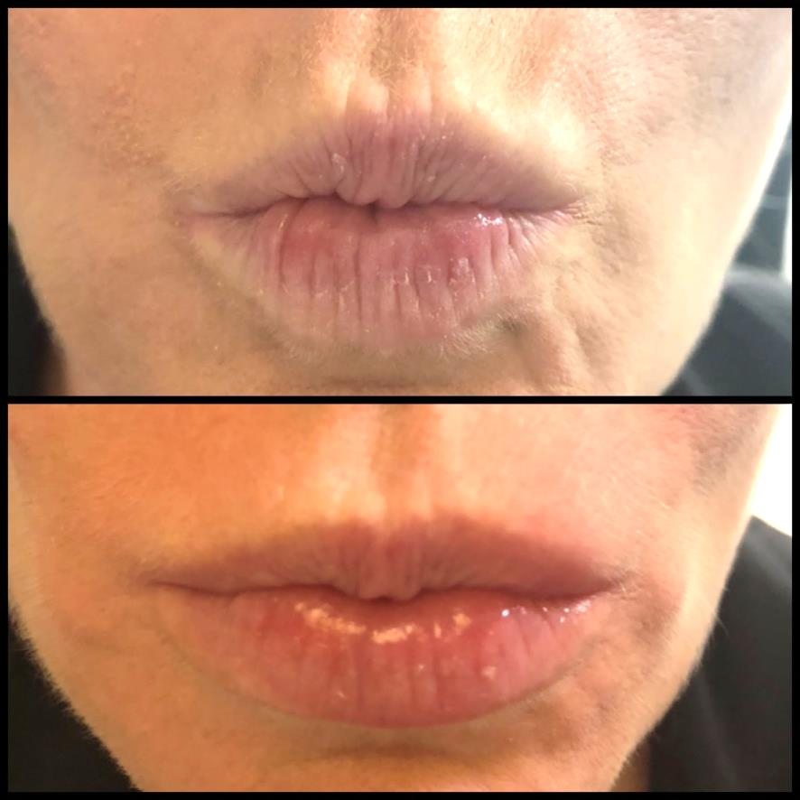
BIO NUTRI LIPS
NATURAL RESULTS – static and dynamic

Slide 25
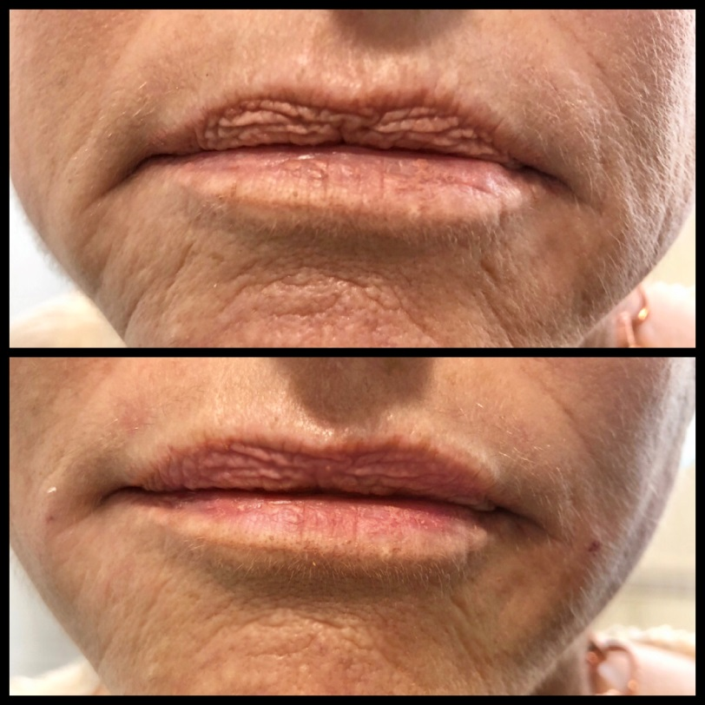
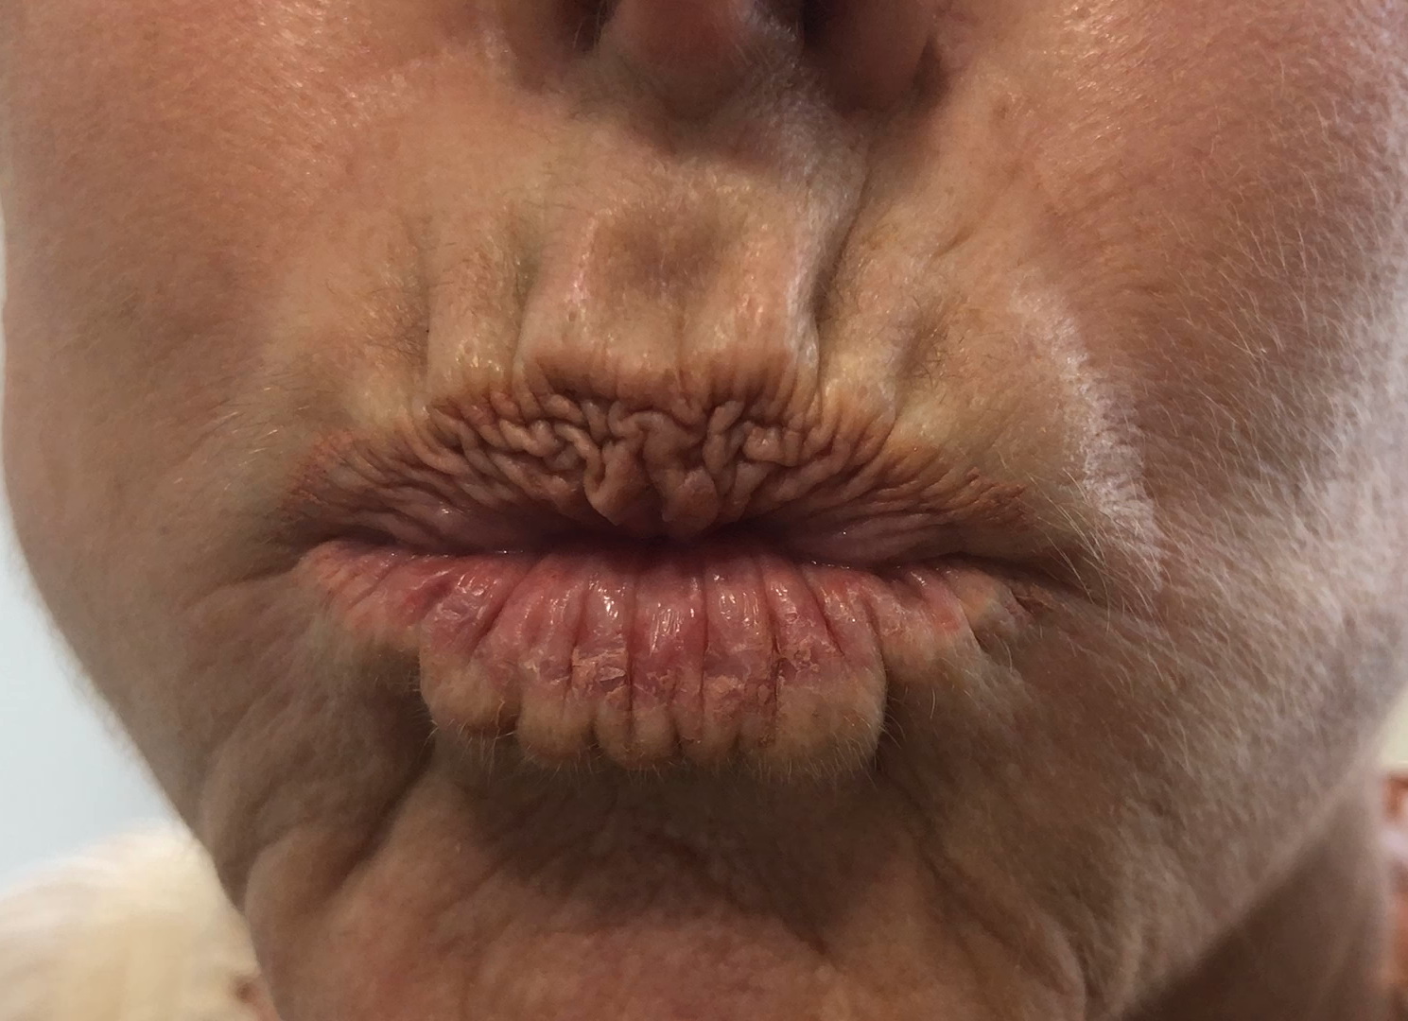
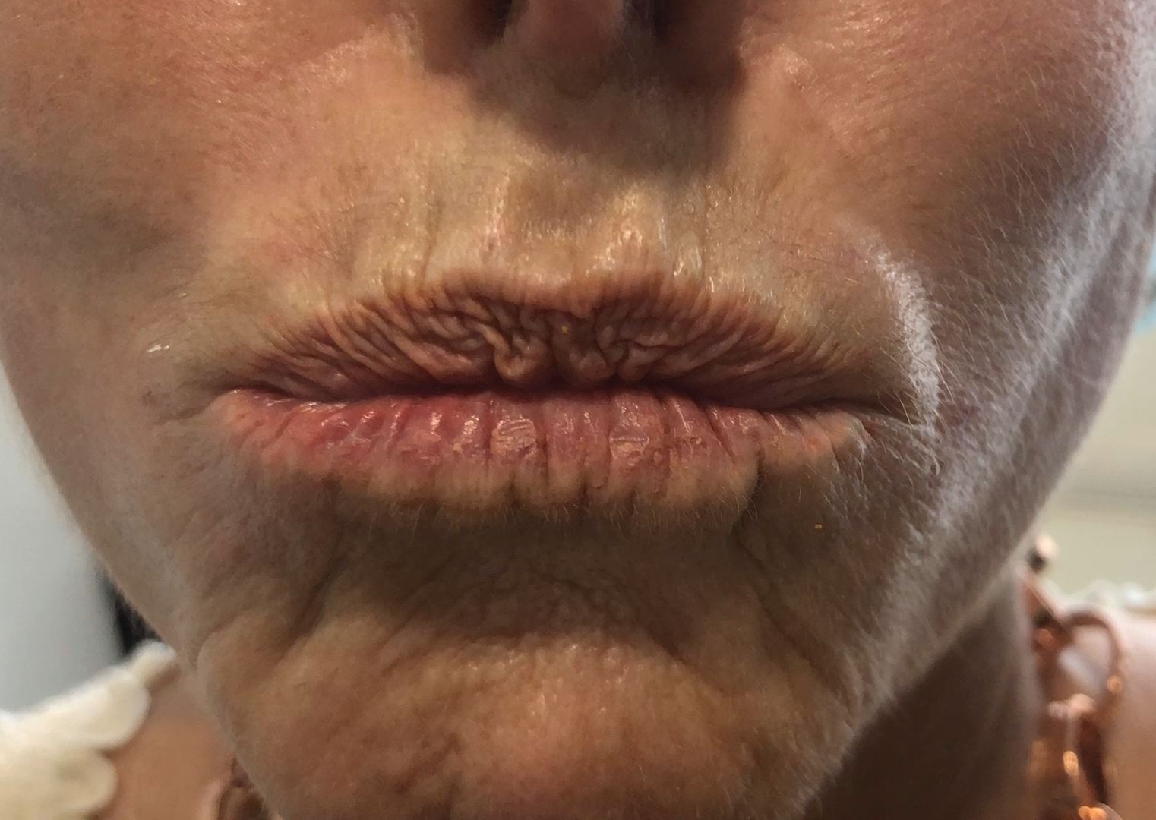
BIO NUTRI LIPS
NATURAL RESULTS – static and dynamic

