Slide 1
Anatomy of the Temple Region

Slide 2
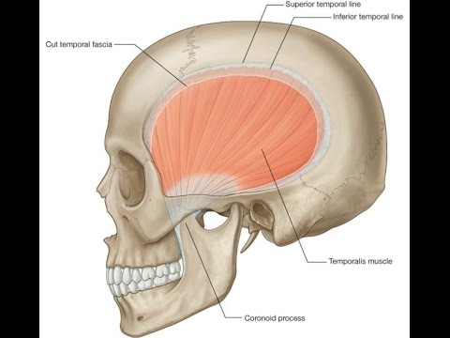
Definition of the Temple
The temporal region or fossa is the shallow depression on the lateral side of the head which houses the temporal muscle-temporalis.

Slide 3
Boundaries of the Temporal Fossa
Superior-Superior Temporal Line
Inferior-Upper border of the Zygomatic Arch
Floor-4 bones of the Skull
Roof- Skin and Temporal Fascia

Slide 5
Temporalis Muscle
The Temporalis is a muscle of mastication. It is a broad fan shaped muscle on each side of the head that fills the temporal fossa. It passes beneath the zygomatic arch forming a tendon that inserts into the coronoid process and ramus of the mandible.
It originates from the floor of the fossa and is very adherent to the bone.
Its upper border is delineated by the superior temporal line.
The muscle is covered by the deep temporal fascia which is a continuation of the periosteum of the scalp.

Slide 6
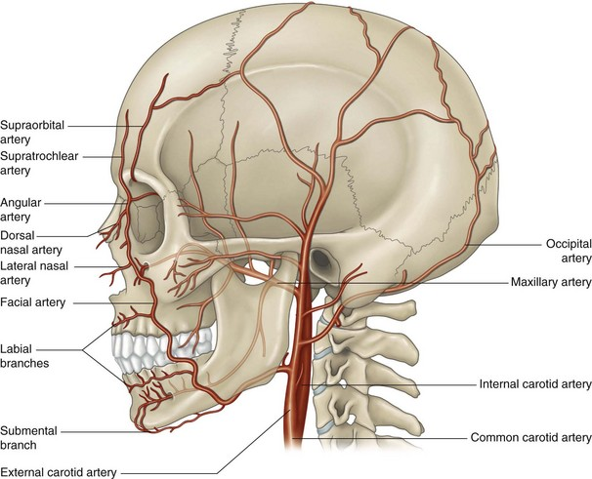
Blood Supply to the Temporal Muscle
This comes from the middle temporal artery-a deep branch of the superficial temporal artery
Also from the deep temporal arteries-which are branches of the maxillary artery ( which is a terminal branch of the superficial artery)

Slide 7
Superficial Temporal Artery
The superficial temporal artery is one of the most important arteries of the head and scalp
It is a terminal branch of the external carotid artery
Emerges from the body of the parotid and crosses over the lateral root of the zygomatic arch
About 5 cm above this it divides into an anterior branch and parietal branch supplying the skin of the scalp
Generally runs anterior to the hair line in the superficial temporal fossa and then anastomoses with branches of the supratrochlear and supraorbital arteries

Slide 9
Nerve Supply to the Temporal Fossa
Deep Temporal Nerves which are branches of the mandibular division of the Trigeminal nerve
Temporal branches of the Facial Nerve
Whilst this is important it is very rarely clinically relevant to dermal filler injections.

Slide 10
Layers of the Temporal Fossa
Skin
Subcutaneous fat
Superficial Temporal fascia-in which the superficial arteries and nerves run-this is continuous with the galea on scalp and SMAS lower down
Deep Temporal Fascia-this is continuous with the periosteum of the scalp and parotid fascia lower down
Bone

Slide 12
Injection Technique
Imagine that the temporal fossa is like a swimming pool
We have a shallow end and a deep end
We can inject in the shallow end with a cannula (bearing in mind the proximity of the superficial temporal vessels and their depth
Or we can inject in the deep end using a needle-this must be on the bone. Using the Arthur Swift technique i.e. 1cm along the temporal fusion line and 1cm back-see demo

